Slide 1
744 Midterm Review

Slide 2
Hadoop Distributed File System
Goals
Store large datasets reliability
Stream those datasets at high bandwidth to user applications (high throughput rather than low latency)
Run on commodity hardware (low-cost)
Write-once-read-many access model to files
Benefits
Scalable - easily grown by adding more nodes
Fault Tolerance
Flexibility - store any amount of any kind of data

Slide 3
Architecture
Files broken into blocks of 128 MB (default)
File can be made up of several blocks
Each block replicated across machines to prevent loss of data
Metadata stored on NameNode and application data on DataNodes

Slide 4
NameNode
Metadata stored on dedicated server called the NameNode
Maintains namespace tree and mapping of file blocks to DataNodes
“Image” - metadata of the name system. Contains the inodes data and list of blocks belonging to each file
“Checkpoint” - persistent record of image stored in host’s native file system
“Journal” - modification log of image stored on NameNode
Notes:
During restarts, NameNode restores namespace by reading checkpoint and replaying journal

Slide 5
DataNode
Stores block data (and some metadata like checksums and generation stamp)
On startup
Connects to NameNode and performs handshake -- verifies namespace ID and software version
Registers with NameNode with its unique storage ID
Block reports to NameNode
Heartbeats to NameNode to confirm is operating. NameNode can reply with various instructions
Notes:
The namespace ID is assigned to the file system instance when it is formatted. The namespace ID is persistently stored on all nodes of the cluster. Nodes with a different namespace ID will not be able to join the cluster, thus preserving the integrity of the file system.

Slide 6
Client
Reading
1. Client contacts NameNode for locations of data blocks comprising the file
2. Client reads block contents from the DataNode
Writing
1. For each block, client requests NameNode to nominate 3 DataNodes to host the block replicas
2. Writes to DataNodes in a pipeline fashion

Slide 7
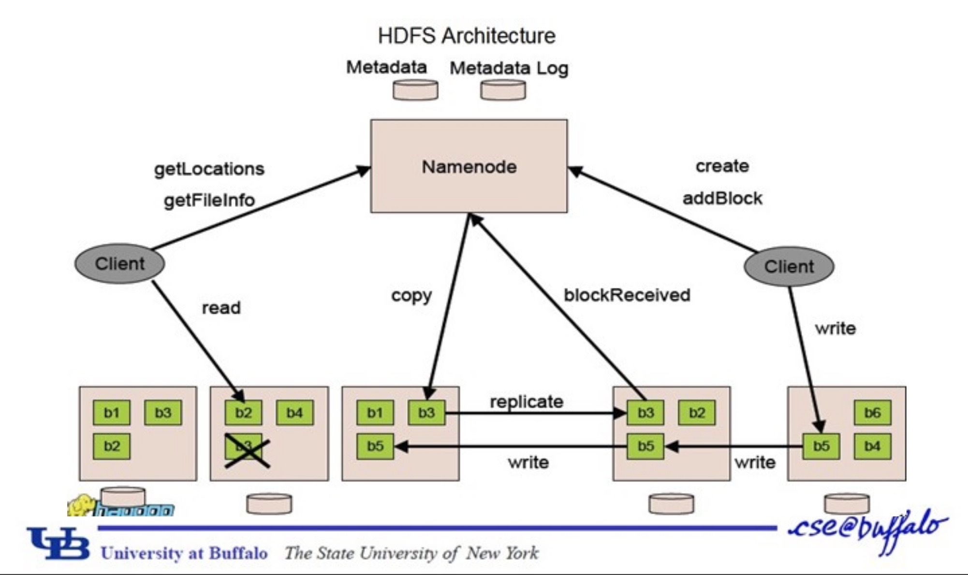
Notes:
Left shows a read, right side shows a right

Slide 8
MapReduce
A Programming Model
Web search, inverted indexes, etc
Want:
Automatic Parallelization
Network, disk optimization
Handle machine failures

Slide 9
MapReduce: Programming Model
Map
(K_{in},V_{in}) -> list(K_{inter},V_{inter})
Reduce
(K_{inter}, list(V_{inter})) -> list(K_{out}, V_{out})

Slide 10
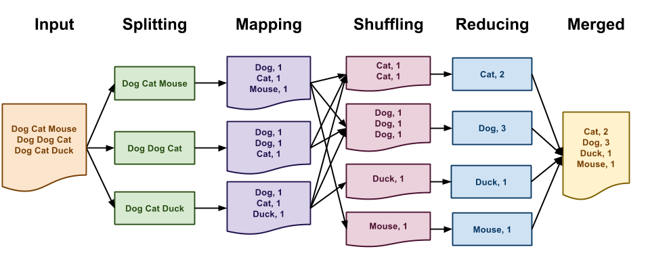
https://www3.nd.edu/~pbui/teaching/cse.30331.fa16/challenge11.html
Notes:
Classic example of word count.
1. MapReduce library splits the input int M pieces and starts up many copies of the program
2. One is the master. It assigns map and reduce tasks
3. Map worker reads corresponding input, runs map function, buffers key/value pairs
4. Periodically buffered pairs are written to local disk, partitioned into R regions. These locations are sent back to master who forwards these to reducers
5-6. Reducer uses RPCs to read data. Once it has all of it, it sorts it, then runs the reduce function, and the output is appended to its output file
7. When all completed, wakes up user program.

Slide 11
MapReduce
Fault Recovery
Crashed task is retried on another node
Master failure aborts the program
Locality - attempts to schedule tasks near corresponding data

Slide 12
MapReduce
Combiners - reduce locally before sending to reducer to lower network traffic
Stragglers - launch backup tasks when job close to completion

Slide 13
MapReduce: Shortcomings
Most applications require multiple MR steps
MR only provides one pass of computation
Data must be written to file system in between
Expensive for data reuse

Slide 14
Spark
Resilient Distributed Datasets
Readonly, partitioned collections of records
Provide restricted programming model by allowing coarse-grained transformations (maps, filters, joins)
This abstraction allows for efficient data reuse but general enough to describe different parallel applications

Slide 15
Spark
RDD Advantages
Fault tolerance with lineage graph instead of replication or checkpointing
Not materialized until needed
Intermediate RDDs can be stored in memory instead of written to disk (great for iterative computations)

Slide 16
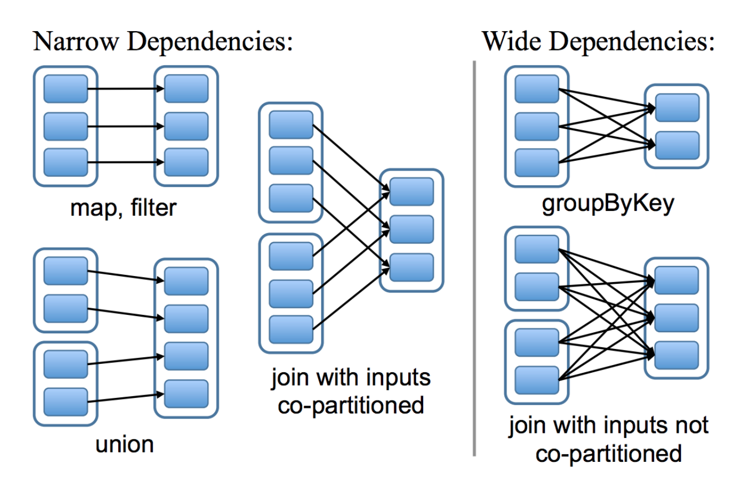
Spark
Notes:
Narrow dependencies: each partition of the parent RDD is used by at most one partition of the child RDD. Allows for pipelining.
Wide dependencies: where multiple child partitions may depend on it

Slide 17
YARN
Separates resource management from the programming model
Requirements include:
Scalable
Locality Aware
Programming model diversity
Etc
Resource Manager, Application Master, and Node Manager

Slide 18
Resource Manager
Per-cluster
Runs on dedicated machine
Acts as central authority arbitrating resources
Exchanges heartbeats with Node Managers to keep consistent global view of cluster
Doesn’t provide status for running applications or serving framework-specific reports -- just a scheduler

Slide 19
YARN
Node Manager
Per-machine agent
Manages life-cycle of container
Monitors health of node
Application Master
Coordinates the application’s execution
Encodes preferences in heartbeat to RM and receives lease in subsequent heartbeats

Slide 20
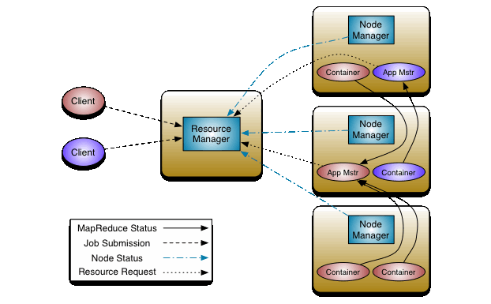
YARN
https://hadoop.apache.org/docs/current/hadoop-yarn/hadoop-yarn-site/YARN.html

Slide 21
DRF
Example Problem:
Consider a system with of 10 CPUs, 20 GB RAM, and two users, where user A runs tasks with demand vector <3 CPU, 2 GB>, and user B runs tasks with demand vector <1 CPU, 5 GB> each. How many tasks will be allocated by DRF to each user?
Solved on Blackboard
Key Properties:
Sharing Incentive: Sharing is better than user having 1/n of all resources
Strategy-proofness: User cannot get better allocation by lying about its demands
Envy-freeness: User does not prefer some other users allocation
Pareto Efficiency: Maximal resource utilization subject to satisfying above properties

Slide 22
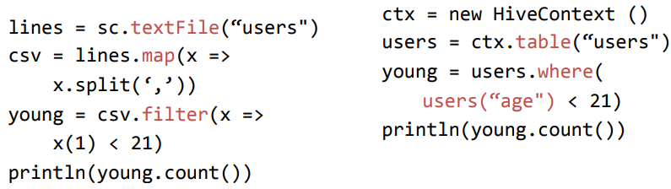
SparkSQL
Main Abstraction: Dataframe = RDD + Schema
Dataframe enables relational operations - projection (select), filter (where), join, and aggregations (groupBy) - that take in expressions in a limited DSL
Build an Abstract Syntax Tree (AST)

Slide 23
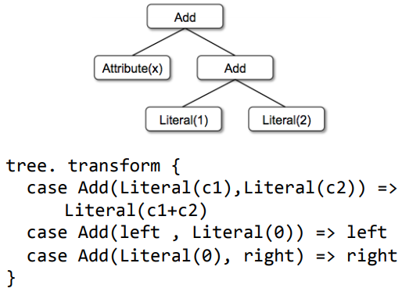
SparkSQL - Catalyst Optimizer
Logical Plan Optimization: Take in trees (AST) and applies rules to simplify
Rules = Pattern Match on subtree and replace by simplified subtree
Physical Plan Optimization: Generate multiple plans and use plan with the least cost

Slide 24
Clarinet - Geo-Distributed Analytics
Motivation: Cost of a physical plan is dependent on WAN-link bandwidths and how inter-datacenter over-the-WAN data transfers are scheduled
For a Single Query -
Cost = Estimated running time with optimal data transfer schedule given current WAN-link bandwidths (lower is better)
For Multiple Queries -
Co-optimize physical plan selection for all queries (evaluate exponential number of choices)
Cost has to be contention-aware
Use shortest job first (SJF) heuristic - Pick shortest physical plan from across all queries, reserve resources, and repeat

Slide 25
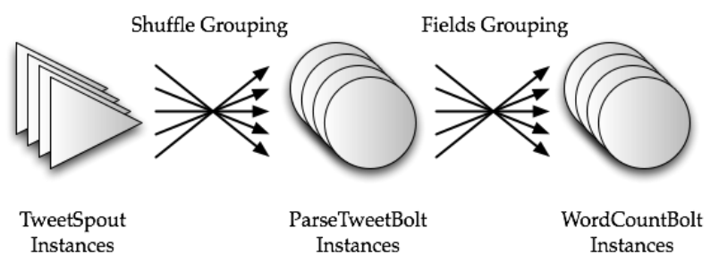
Storm - Programming Model
Topologies (DAGs of spouts and bolts)
Input : Tuples

Slide 26
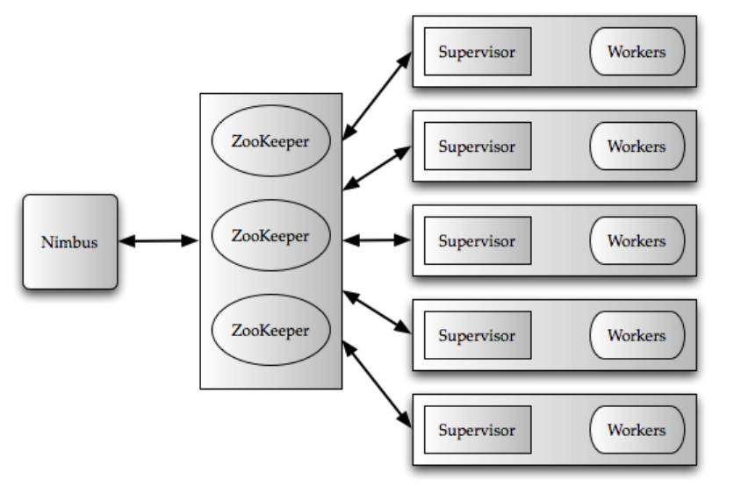
Storm - Architecture Overview

Slide 27
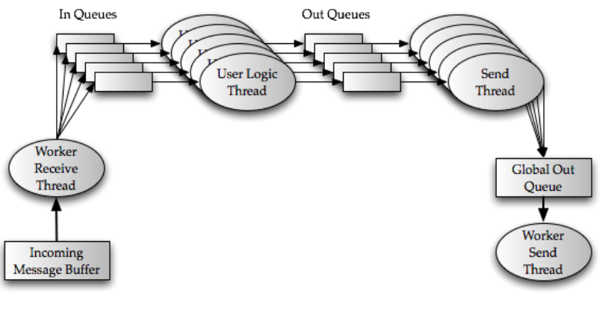
Storm - Message Flow @ Worker

Slide 28
Storm - Processing Semantics and Limitations
Supports atmost once and atleast once semantics
Atleast once semantics provided via
AckerBolt
Provenance Tracking
Limitations
No support for processing out-of-order data
Contention @ worker queues

Slide 29
Spark Streaming
Goals
Scale to hundreds of nodes
Second scale processing latencies
Second scale recovery from faults as well as stragglers
Prior systems based on continuous operator model
Makes it hard to deal with faults as well as stragglers in a timely fashion
Approaches
Replication
Upstream Backup

Slide 30
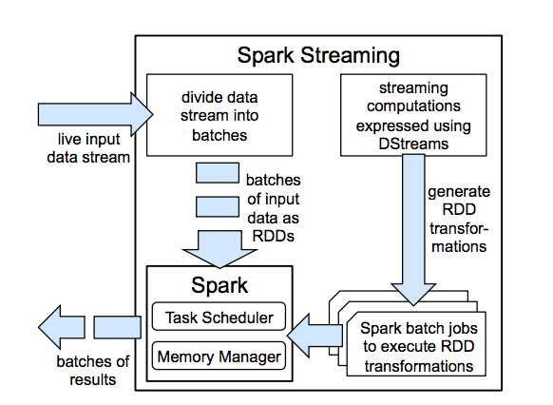
Spark Streaming - Discretized Streams
Stateful Operations --- series of time-ordered stateless batch jobs

Slide 31
Spark Streaming - Fault Tolerance
Extend RDDs lineage across time and leverage RDD’s recovery mechanisms in the presence of failures
Recovery of the failed partitions can be done in parallel -- leading to fast recovery

Slide 32
Spark Streaming - Processing Semantics
Exactly once semantics
Computation is deterministics, stateless and ordered by time

